Slide 1
Copy P:\! DoML Week1 into your MATLAB Folder

Slide 2
Linear Regression and Machine Learning

Slide 3
Machine Learning: Perception
When data exists, we want to find patterns
But we don’t actually want to have to do it ourselves
Machine Learning is Automated Pattern recognition
Based on data, finding a set of mathematical rules to explain/ predict
We want to characterize the relation between independent and dependent variables
Generally denoted as x and y

Slide 4
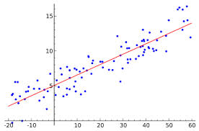
Linear Models: They’re great
Many systems have linear relationships
These are some of the easiest to find
Linear regression finds a linear model or relationship between inputs (x) and outputs (y)

Slide 5
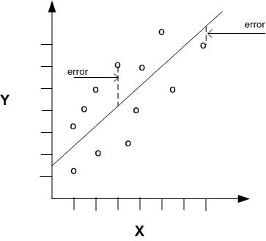
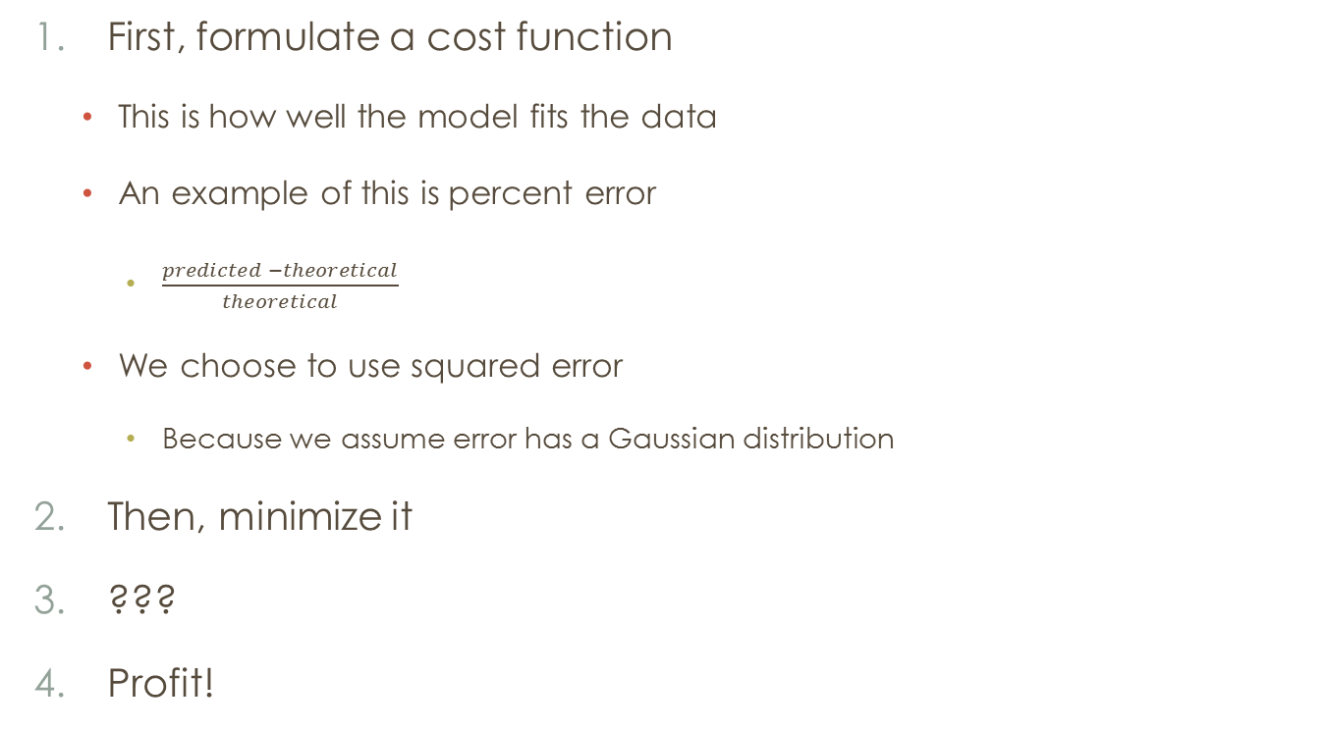
But how does it work?
First, formulate a cost function
This is how well the model fits the data
An example of this is percent error
$\frac{predicted −theoretical}{theoretical}$
We choose to use squared error
Because we assume error has a Gaussian distribution
Then, minimize it
???
Profit!

Slide 6
mATH: some people like it
Each point has quadratic error from the hypothesis
The sum of these errors is quadratic
Which can be plotted as a parabola
To solve for the minimum error, take the derivative
To Generalize:
Parabola → Paraboloid
Derivative → Gradient
Notes:
On this slide: write out error terms, gradient term, introduce derivatives -> gradient descent

Slide 7
Data: Swedish insurance
P:\! DoML Week1
Auto Insurance in Sweden
X_{i} = number of claims
Y_{i} = total payment for all the claims in thousands of Swedish Kronor for geographical zones in Sweden
Reference: Swedish Committee on Analysis of Risk Premium in Motor Insurance
Now: walk through a matlab implementation

Slide 8
Preparing the Dataset
In order to make a useful model, it needs to generalize to new datasets
You already know how your training data behaves
In order to prevent overfitting, you can split your dataset into two groups:
Training data
Use to create the model
Test data
Used to validate your model
Notes:
Ask for pseudo code at the end of the slide: Write in your own words what the purpose is, what are the inputs, outputs? What operations need to be done on the data?

Slide 9
Analysis
How did the model perform on train data? on test data?
Discuss dangers of over fitting
Introduce concept of generalization
Because you rarely only need to model your training data
Making predictions on new data sets is important
Notes:
Show the overfitted model

Slide 10
Ridge Regression
Simple models are generally better
Still able to model when new data is added
Ridge regression penalizes functions for becoming more complex
As the weights get bigger, the penalty also increases forcing the model to generalize – to remove spurious correlations
gradient = 2*X'*X*w - 2*X'*y + 2*lambda*w;
Notes:
At end of slide go back to Matlab and show how to exchange linear regression cost function for the ridge regression cost function, also write on board what new cost function is

Slide 11
TL;DR
Goal #1: Perceive a pattern
A linear pattern
Go from training data to test data
Make sure the model generalizes
Accomplish this by penalizing error and complexity

Slide 12
What now?
These same ideas apply to different model relationships
logistic regression: the classification problem
Neural Nets: Stacks of linear or logistic models
Faking nonlinear models: higher order projection
Modeling Physical Systems
Mass-Spring-Damper, Pendulum
The wider world: Control Problems, Bayesian Interpretations, Convex Optimization

